Slide 1
Developer Portfolio Website
Avas Ali

Slide 2
Introduction
In today’s competitive market, having a portfolio website is really important to demonstrate our developer skills and make ourselves stand out from the rest of the developers by showcasing our projects.

Slide 3
The key questions?
Who are we targeting?
What is the purpose of this website?
What technologies are we using to build this website?
What devices can access this website?
What design approach are we going to use for building this website?
How are we going to make is accessible?

Slide 4
The target audience
The main target audience are the prospective employers who were are showcasing our developer skills. However, in general, anyone can access our websites to have a look at our portfolio.

Slide 5
Technologies used
HTML5
CSS
Bootstrap CSS( A CSS Framework built by Twitter to make our website interactive and appealing).

Slide 6
What devices can access this website?
The user can access the website using the following devices:
Mobile Devices
Tablets
Computers

Slide 7
The design approach
When building a website, we first create a blueprint of the how the website will look like and how the elements of the website react when the user interacts with it and how the order and size of the elements change when we change the size of the display?

Slide 8
Wireframing
Wireframe is more like a blueprint of how the website(in other words designing a webpage) will look like when we displayed on various devices. This also includes the theme of the website, the color coding of the website.

Slide 9
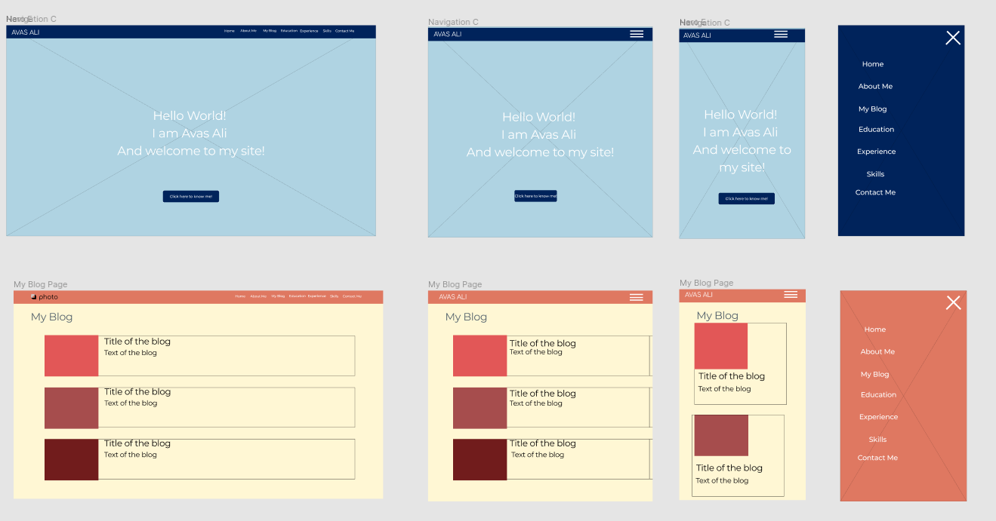
Our wireframe for the portfolio website
Computer
Tablet
Mobile

Slide 10
How to achieve this design using code?
We use CSS and it’s frameworks. We use the following techniques:
Box Model Approach
Flexbox method to arrange the elements/components in the HTML Content
Grid System: Dividing the webpage into set of grids(achieved using BootstrapCSS)
Rearrange the order of the elements and resize them(achieved using @media query)

Slide 11
Aesthetics used
Color coding.
Arrangement of items.
Resizing of items.

Slide 12
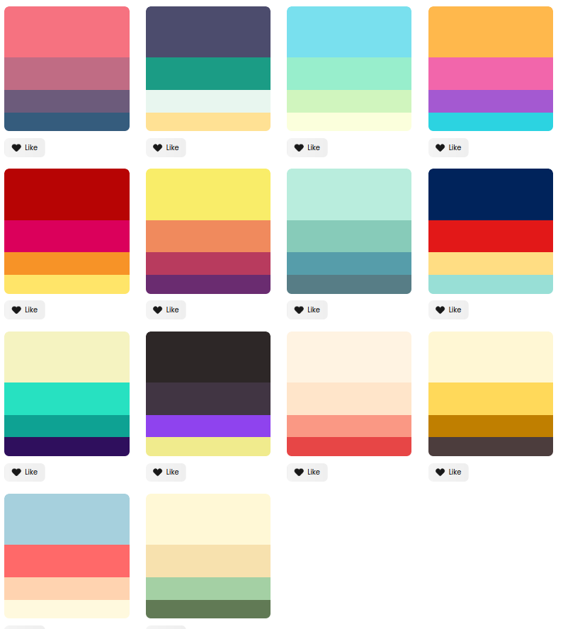
Color coding
This was achieved from www.colorhunt.com
Colors were chosen from the picture on right:
Usually navigation bars had darker colors
To background:
Example:
Navigation bar : #E74646
Background: #FA9884

Slide 13
List of key components used
Navigation bar
Cards
Progress bars
Forms

Slide 14
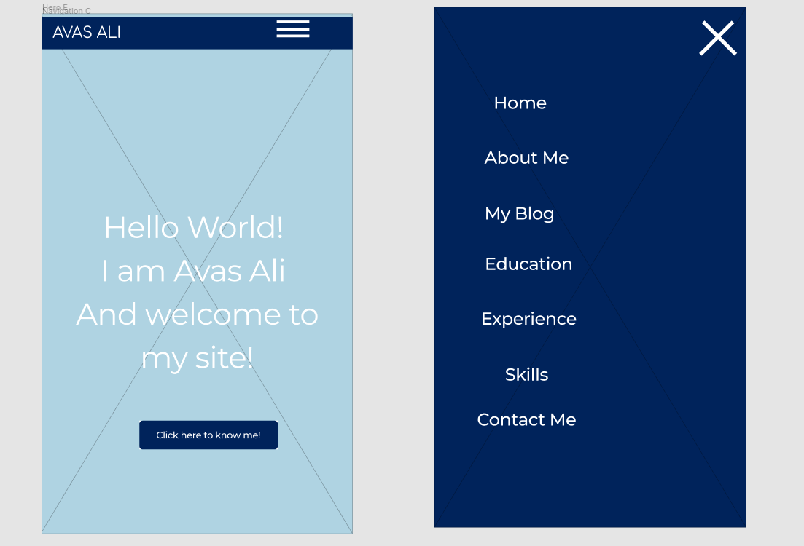
Navigation Bar
Important component in css that helps us navigate through various webpages/parts of webpages. For smaller devices, the navigation bar collapses to a hamburger icon and when we click on the icon it is drops down to give use the navigation items.

Slide 15
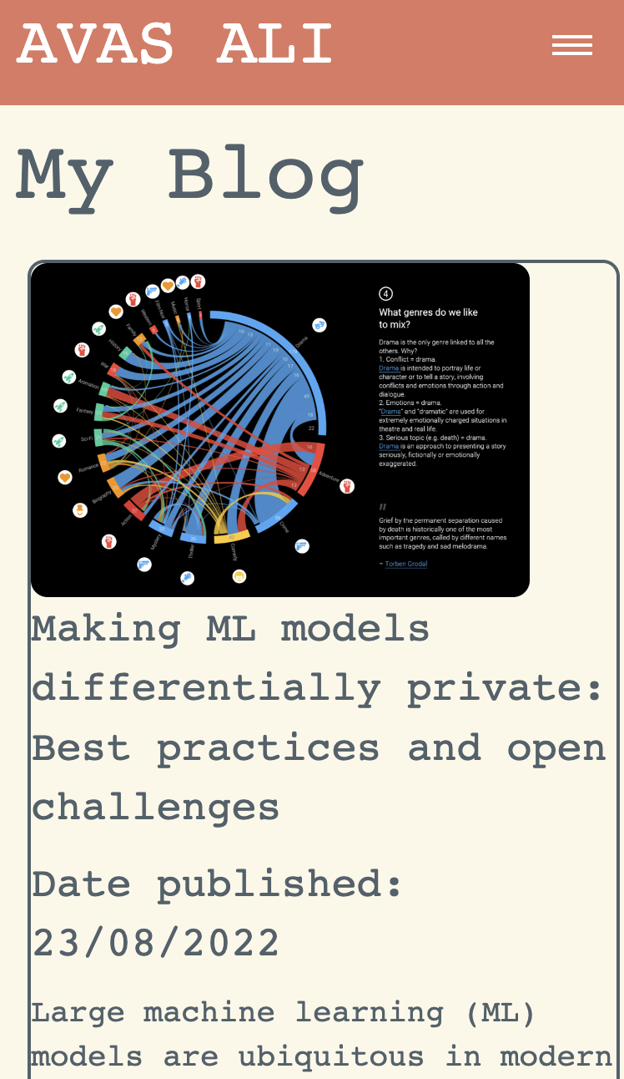
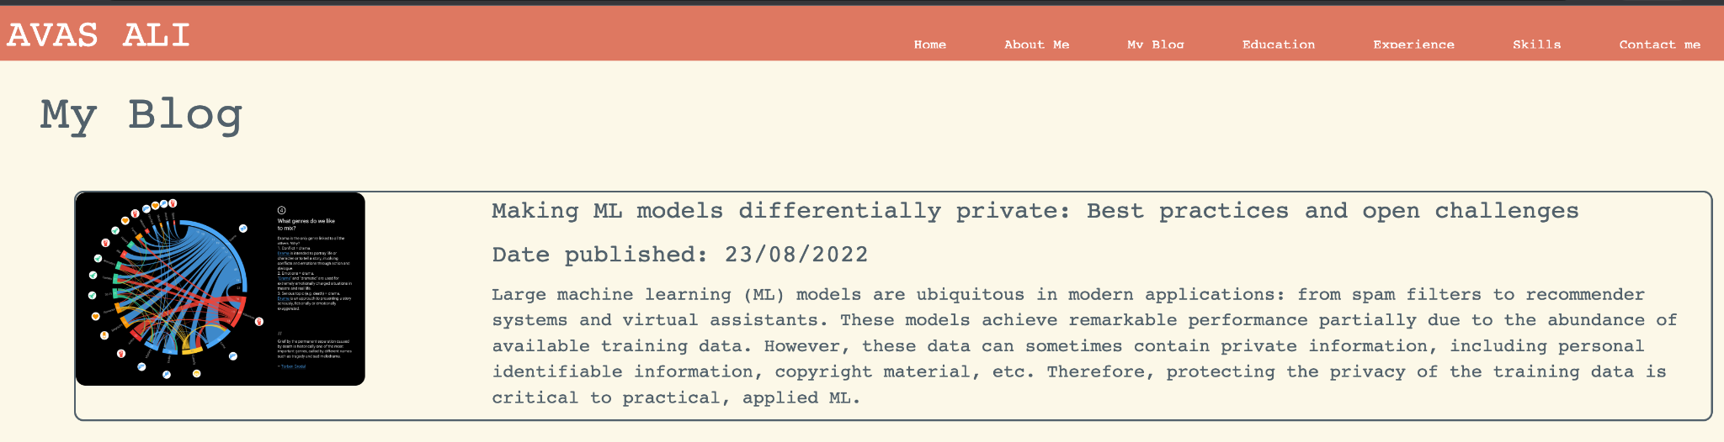
Cards
Cards we used in experience and blog section of the website. These are regular containers that were modified according to the aesthetics in order to meet the design requirements. Achieved using flex-box with flex-box direction as columns.It means the blog items were on top of each other like a stack in the container. The grid approach to divide each members of the container using col-sm-3 for image and col-sm-9 for content.

Slide 16
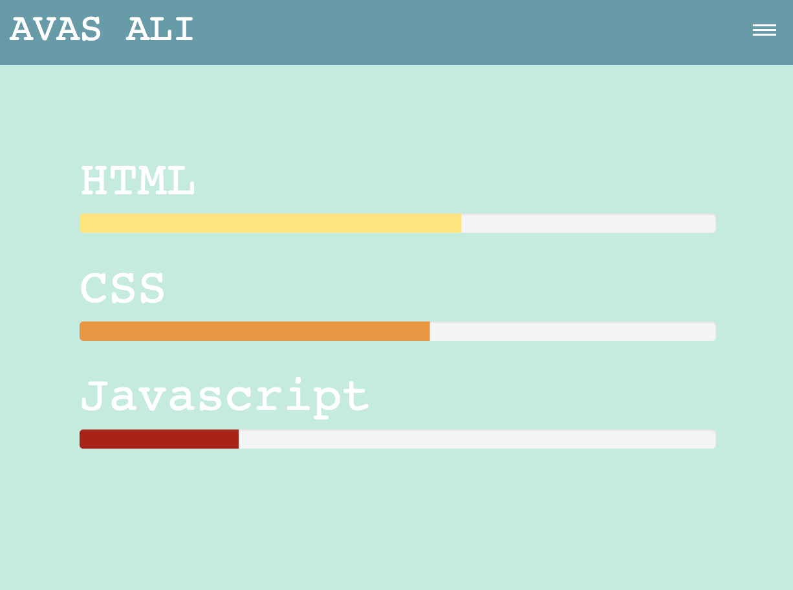
Progress bars
This was implemented on the skills website to demonstrate the amount of knowledge and expertise I have on each of my skills. This can be achieved using the bootstrap css progress bars.

Slide 17
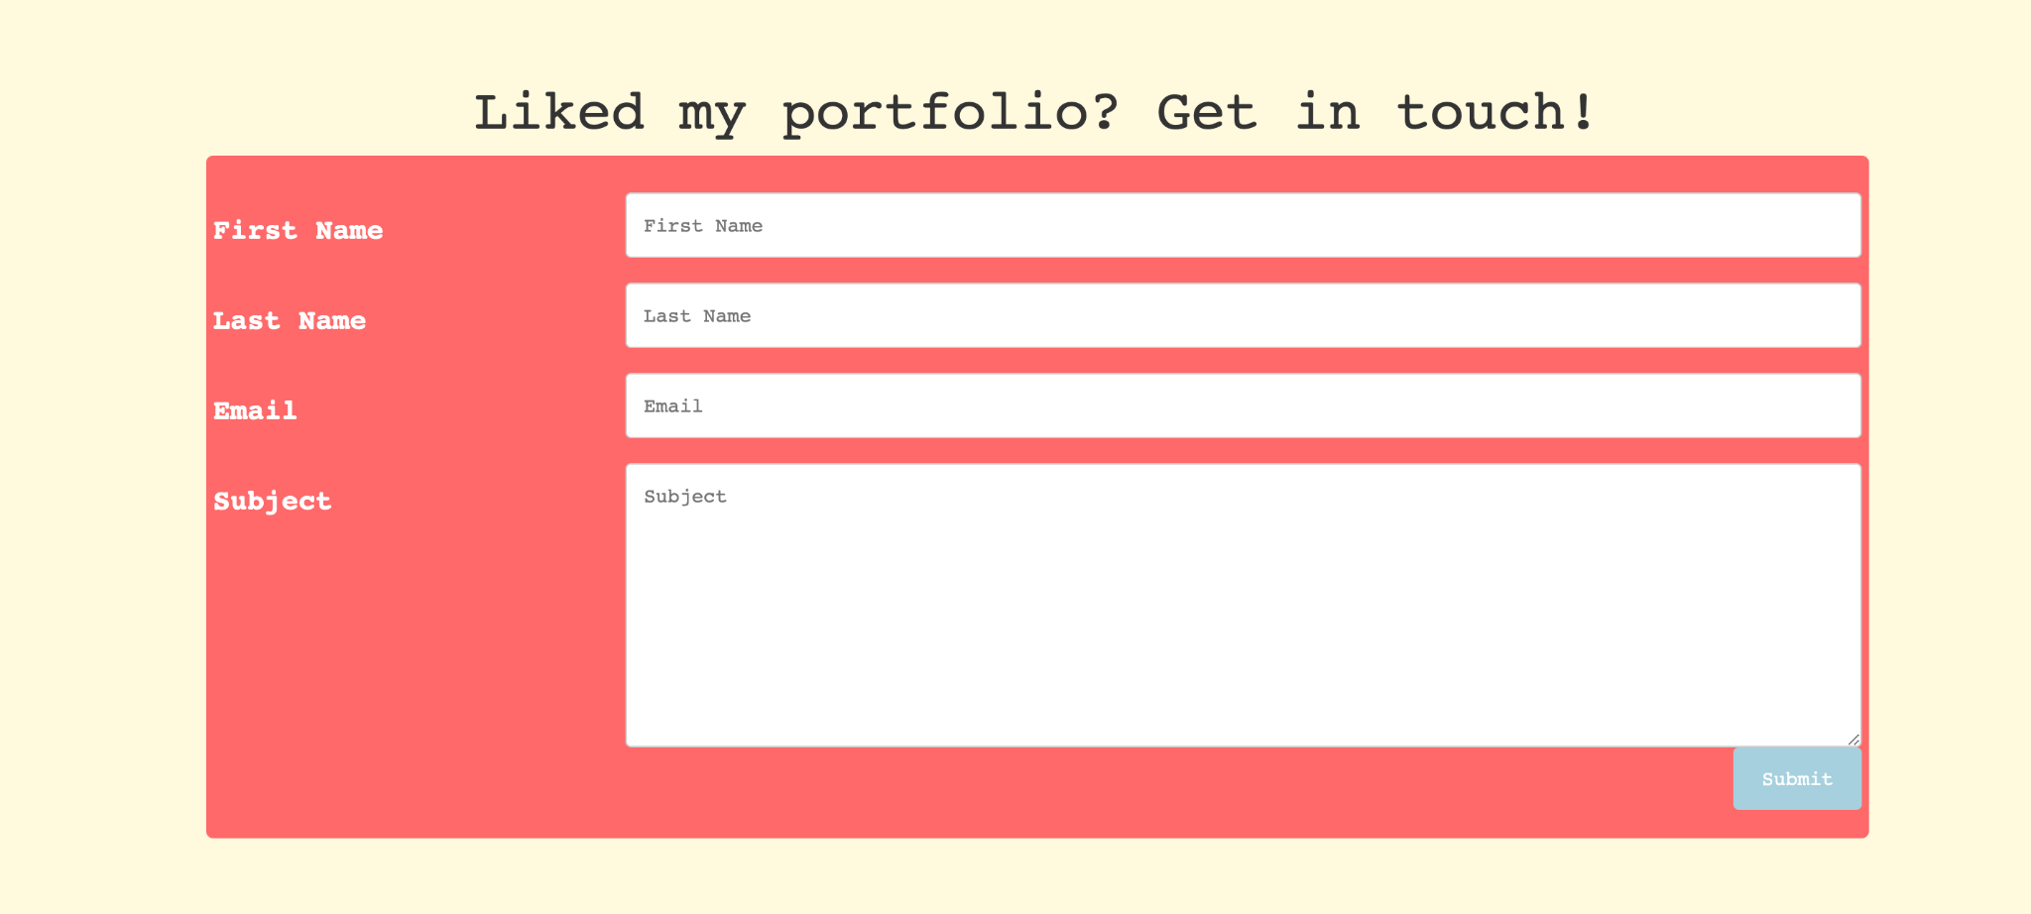
Forms
Forms are important components that collect user input such a text fields,numbers etc. I used for user to submit the contact detail to contact me.The were arranged using bootstrap css grids.

Slide 18
Conclusion
Design plays an important role in building a website as it briefly gives an idea as to what the website is going to look like. The design can be improve further if required as per the user requirements.
Responsive website should be used starting from mobile first.
Arranging components while deciding the entire design is indeed challenging and can have many bugs.
Small changes to code can influence big changes on the website. So, we need to be careful while coding the components of the webpage.

Slide 19
Thank You!

